Slide 1
Chapter 8 Artificial Neural Networks

Slide 2
Introduction
Neural networks are a class of powerful, flexible, general-purpose techniques readily applied to prediction, estimation, and classification problems.
The first artificial neural networks were conscious attempts to simulate the workings of biological neural networks using digital computers.

Slide 3
The Artificial Neuron
An artificial neuron takes its inputs and produces an output
Overall behavior: node‘s activation function.
The combination function combines the inputs into a single value
Then passed to the transfer function to produce an output.

Slide 4
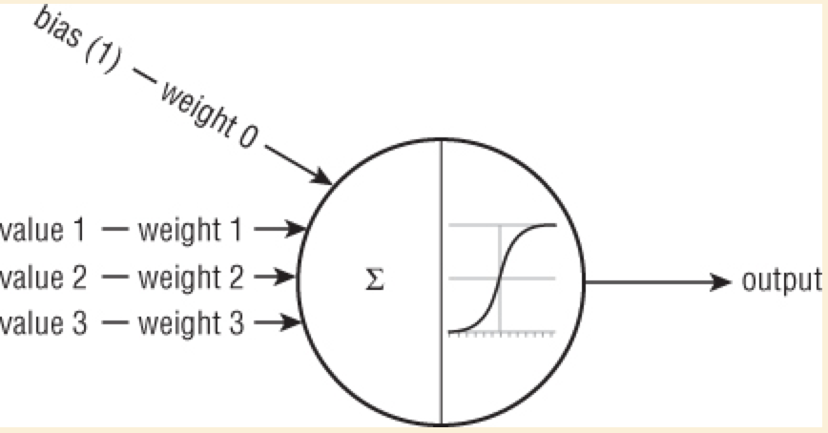
The Artificial Neuron
The output of the unit is typically a nonlinear combination of its inputs.

Slide 5
Combination Function
The combination function typically uses a set of weights assigned to each of the inputs.
A typical combination function is the weighted sum, where each input is multiplied by its weight and these products are added together.

Slide 6
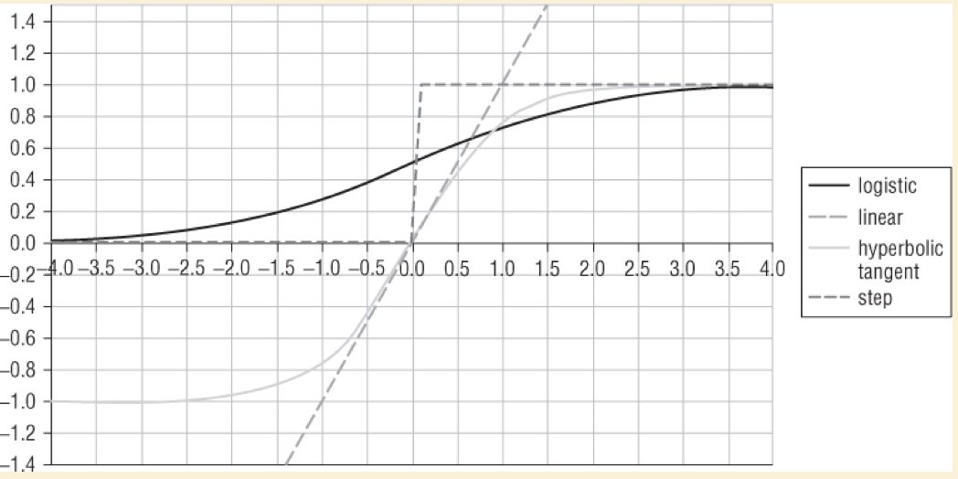
Transfer Function
The choice of transfer function determines how closely the artificial neuron mimics the behavior of a biological neuron
Four common transfer functions are the step, linear, logistic, and hyperbolic tangent functions.

Slide 7
The Multi-Layer Perceptron
Multi-layer perceptrons:
Input layer, where data enters the network;
Second layer, known as the hidden layer comprised of artificial neurons, each of which receives multiple inputs from the input layer.
The artificial neurons summarize their inputs and pass the results to the output layer where they are combined again.

Slide 8
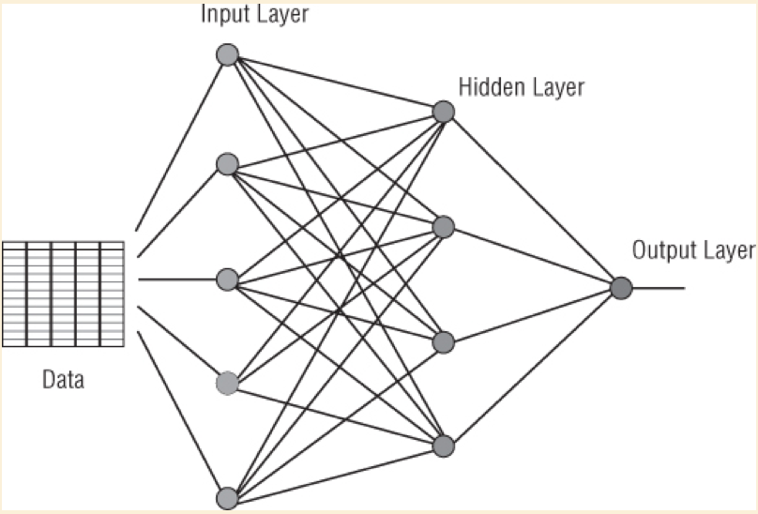
The Multi-Layer Perceptron
A multi-layer perceptron with a single hidden layer.

Slide 9
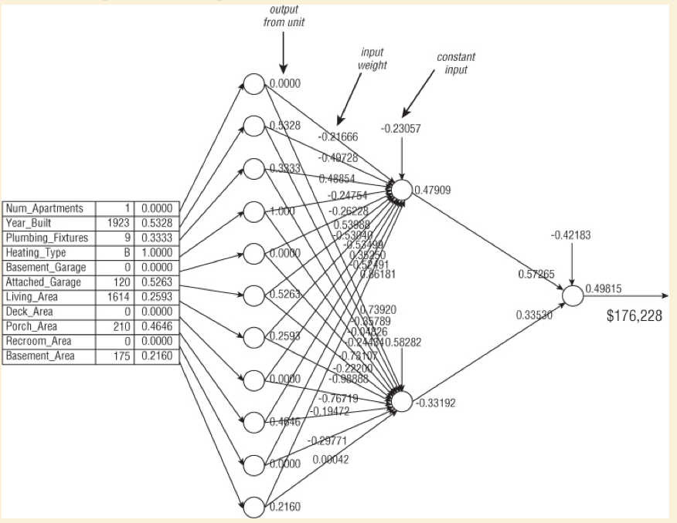
A Network Example
The real estate training example shown here provides the input into a neural network and illustrates that a network is filled with seemingly meaningless weights.

Slide 10
A Network Example
The hidden layer is connected neither to the inputs nor to the output of the network.
Each unit in the hidden layer is typically fully connected to all the units in the input layer.

Slide 11
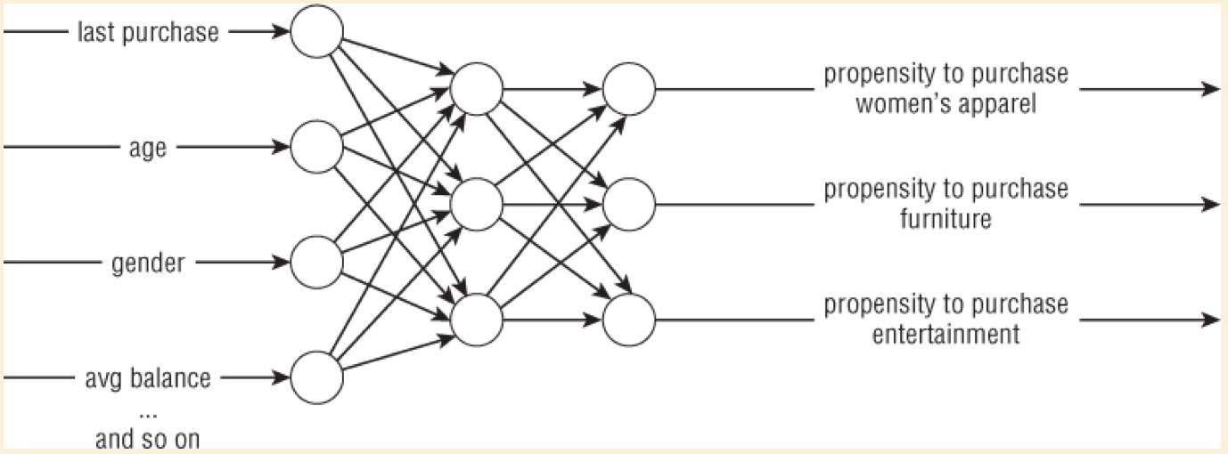
Network Topologies
It is possible for the output layer to have more than one unit.
This network has more than one output and is used to estimate the probability that customers will make a purchase in each of three departments.

Slide 12
Network Topologies
Given three outputs, how can the department store determine the right promotion or promotions to offer the customer?
Take the department corresponding to the output with the maximum value.
Take departments corresponding to the outputs with the top three values.
Take all departments corresponding to the outputs that exceed some threshold value.
Take all departments corresponding to units that are some percentage of the unit with the maximum value.

Slide 13
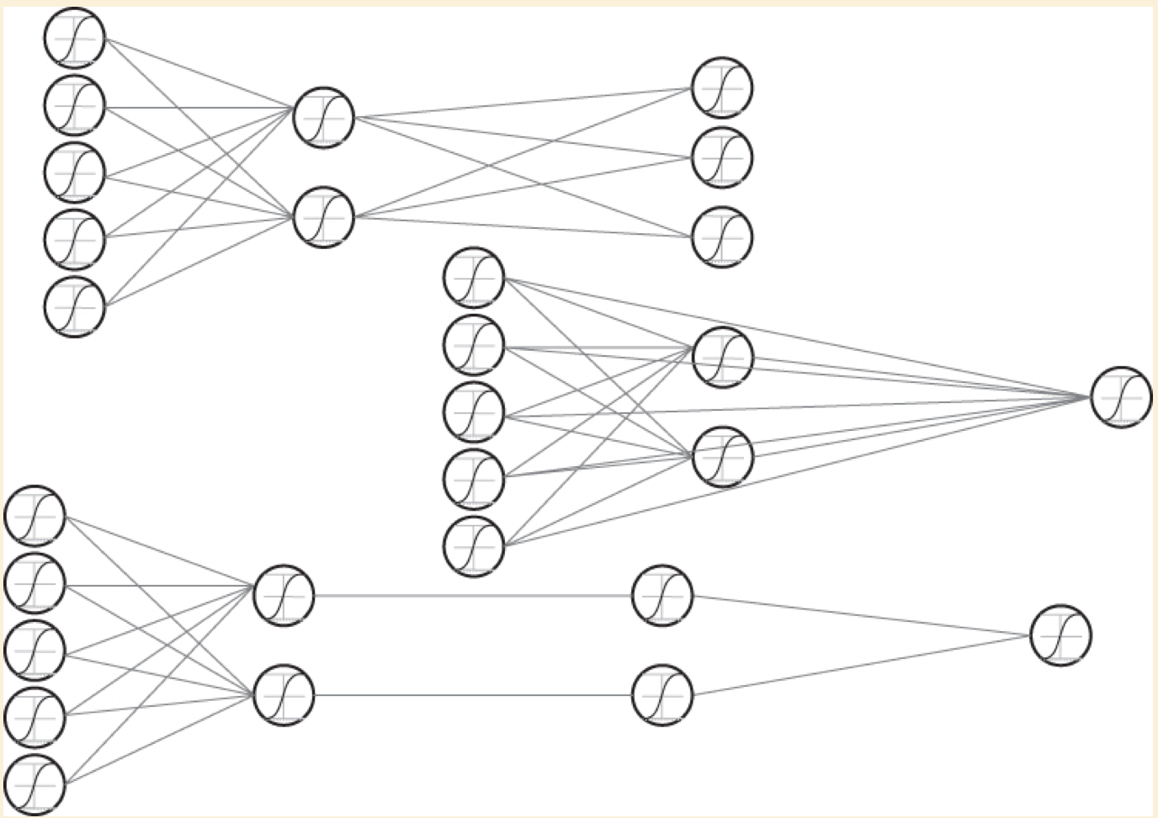
Network Topologies
Several variations on the basic neural network architecture.

Slide 14
A Sample Application: Real Estate Appraisal
A neural network takes specific inputs: the information from the housing sheet
Specific output: an appraised value for the house.
The process of training the network is actually the process of adjusting weights inside it to arrive at the best combination of weights for making the desired predictions.
This process of adjusting weights is sensitive to the representation of the data going in.

Slide 15
A Sample Application: Real Estate Appraisal
After the network has been trained, the performance of each generation must be measured on the validation set to select the generation of weights that minimizes error on data not used for training.
When the model‘s performance on the validation set is satisfactory, the neural network model is ready for use.

Slide 16
Training Neural Networks
Training a neural network means using the training data to adjust the network weights so that the model does a good job of estimating target values for records that are not part of the training data.
the first successful training method and easiest way for neural networks was back propagation.

Slide 17
Back Propagation
Main steps:
The network gets a training example and, using the existing weights in the network, it calculates the output or outputs.
Calculates the error by taking the difference between the calculated result and the actual target value.
The error is fed back through the network and the weights are adjusted to minimize the error.

Slide 18
Pruning a Neural Network
One of the dangers with any of the training techniques is falling into something called a local optimum.
Another danger is overfitting.
An overfit model does not generalize well.
Use validation set in a manner analogous to the pruning of a decision tree.
Each set of weights represents a different candidate model.
These models are applied to the validation set and the model with the lowest error on the validation data is chosen as the final model.

Slide 19
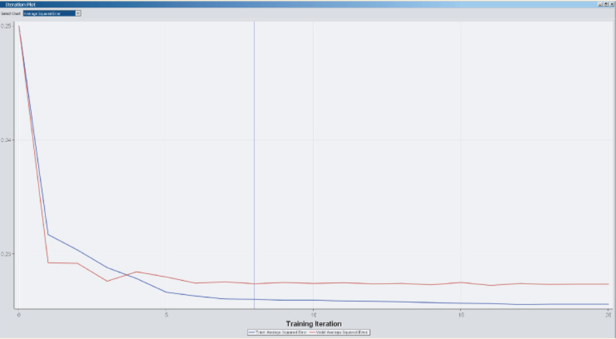
Pruning a Neural Network
After twenty training iterations, error on the training data is nearly zero, but error on the validation data reached its lowest value after just seven iterations

Slide 20
Neural Networks in Practice
Steps of building a NN:
1. Identify the input and output features.
2. Standardize the inputs.
3. Set up a network with an appropriate topology.
4. Train the network on a representative set of training examples.
5. Use the validation set to choose the set of weights that minimizes the error.
6. Evaluate the network using the test set to see how well it performs.
7. Apply the model generated by the network to predict outcomes for unknown inputs.

Slide 21
Neural Networks in Practice
Keys to using neural networks successfully:
The most important issue is choosing the right training set.
The second is representing the data in such a way as to maximize the ability of the network to recognize patterns in it.
The third is interpreting results produced by the network.
Finally, understanding some specific details about how they work, such as network topology and parameters controlling training, can help make better performing networks.

Slide 22
Neural Networks in Practice
The problem of keeping a neural network model up to date is made more difficult by two factors:
The model does not readily express itself in the form of rules, so it may not be obvious when it has grown stale.
When neural networks degrade, they tend to degrade gracefully, making the reduction in performance less obvious.

Slide 23
Choosing the Training Set
Coverage of Values for All Features
Cover the full range of values for all features that the network might encounter, including the output.
Number of Features
More features used as inputs into the network, the larger the network needs to be, increasing the risk of overfitting and increasing the size of the training set.

Slide 24
Choosing the Training Set
Size of Training Set
The more features the network has, the more training examples are needed to get a good coverage of patterns in the data.
Number and Range of Outputs
It is worth checking that the training examples produce outputs across the whole expected range.

Slide 25
Interpreting the Output from a Neural Network
The average value produced by the network during training will be close to the average value in the training set.
Output values can be turned into probability estimates by scoring a validation set and measuring the proportion of each class for different ranges of the output value.
In many cases, the network can have a separate output for each category; that is, a propensity for that category.

Slide 26
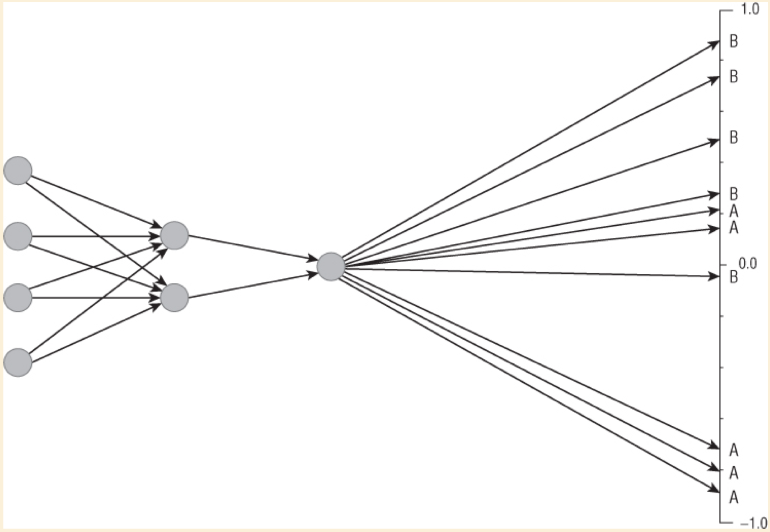
Interpreting the Output from a Neural Network
Running a neural network on examples from the validation set can help determine how to interpret results.

Slide 27
Can Neural Network Models Be Explained?
Even knowing all the weights on all the nodes throughout the network does not give much insight into why the network produces the results that it produces.
Sensitivity Analysis can be used to get an idea of how opaque models work
1. Find the average value for each input. For standardized inputs, the average value is zero.
2. Measure the output of the network when all inputs are at their average value.
3. Measure the output of the network when each input is modified, one at a time, to range through different values.

Slide 28
Can Neural Network Models Be Explained?
Using Rules to Describe the Scores
Use the scores produced by the neural net as the target variable for a regression tree.
This produces leaves containing records that are close to the average score for that leaf along with rules describing each leaf
Although this provides a description of high-scoring and low-scoring segments, it does not actually explain how the scores were arrived at

